Slide 1

Speech Synthesis And Perception With Envelope Cue
谭文杰 安广言

Slide 2
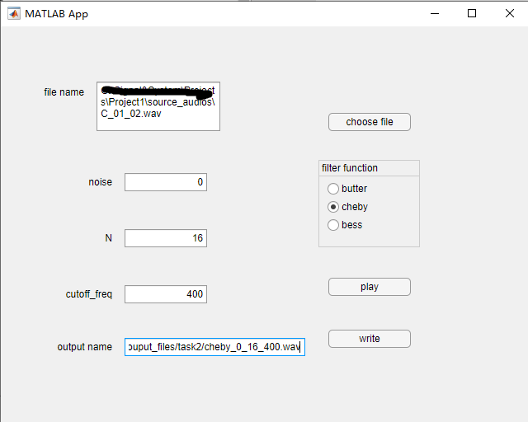
Introduce
In this project, we successfully implemented a vocoder to simulate the behavior of hearing aids and estimated the intelligibility with various parameters and input materials. Furthermore, we explored whether noise reduction can improve hearing aid users’ perceptual experience. And we managed to achieve an GUI by mlapp.
Screen Shot of the app

Slide 3
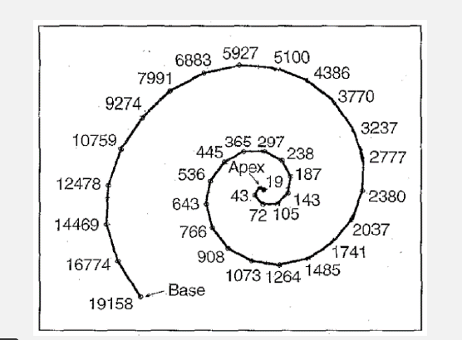
Background Knowledge
$$f=165.4×({10}^{0.06d}−1)$$

Slide 4
Learnings
Our study showed that the number of frequency channels dominates the performance of the vocoder, and CIs are sensitive to the tonal features of inputs. Additionally, the noise reduction approach improves the intelligibility of the performance in a noisy environment.

Slide 5
Results

Slide 6

处理前
Task1
N=1
N=2
N=4
N=6
N=8
N=16

Slide 7
Task2
f=20Hz
f=50Hz
f=100Hz
f=400Hz

Slide 8
Task3(with noise ,SNR=-5)
N=2
N=4
N=6
N=8
N=16

Slide 9
Task4
f=20Hz
f=50Hz
f=100Hz
f=400Hz

Slide 10
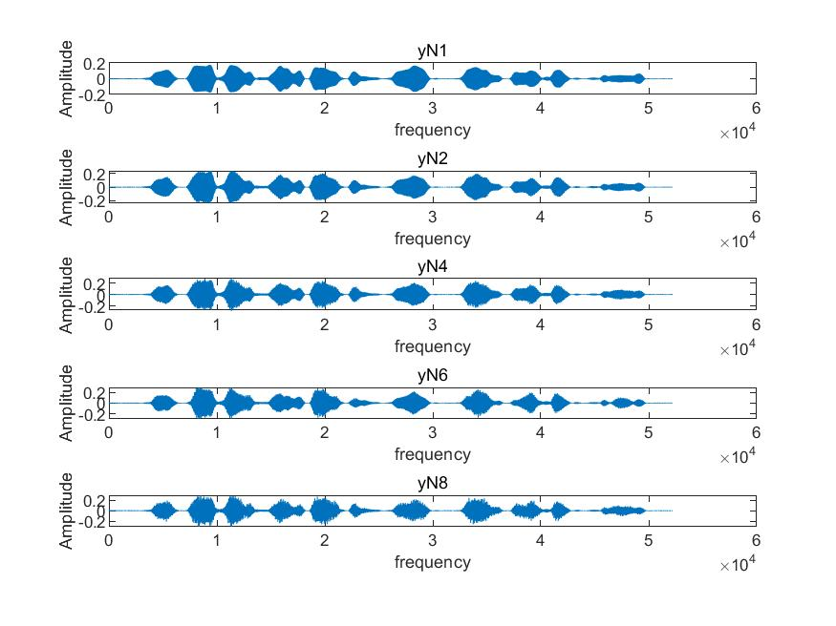

Slide 11
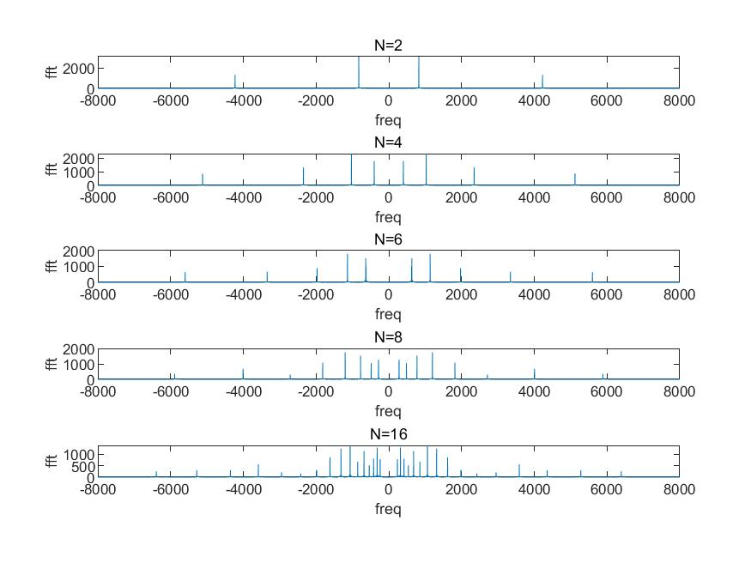

Slide 12
Critical Thinking
First we try to manually split up each sections for different Ns, but we found that too hard when N is relatively large. So we change the way of simulations and use a vectorized one, which really increase our productivity, and further more, gives us an interface which can be linked to the GUI.
Second we compare Butterworth, Chebyshev and Bessel filters.

Slide 14
三种滤波器的比较
巴特沃斯滤波器是一种在通带和阻带都平坦的滤波器，通带率响应曲线最平坦，没有起伏，阻带频带则逐渐下降为零，下降慢，在过渡带上很容易造成失真。
切比雪夫滤波器是在通带或阻带上频率响应幅度等波纹波动（通带平坦、阻带等波纹或是阻带平坦、通带等波纹）的滤波器，振幅特性在通带内是等波纹。
贝赛尔(l)滤波器是具有最大平坦的群延迟（线性相位响应）的线性过滤器，即最平坦的幅度和相位响应，常用在音频天桥系统中。具有最平坦的幅度和相位响应。带通（通常为用户关注区域）的相位响应近乎呈线性。

Slide 15
Team effort
Both of us do the whole project. And we check the others’ codes
One of us makes the GUI
The other compares these three types of filters.

